Slide 1

SkyBits Technologies Private Limited
www.sky-bits.com
Corporate Presentation

Slide 2
SkyBits – Profile
A niche Software Company in AI based Technology Solutions
Focus Areas
Approach
Team
Image Processing
Natural Language Processing
Mobile Technologies
Develop Frameworks
Products & Services based on Frameworks
Founders- IT Industry veterans
Senior Data Scientists
Consultants
Statistical Analysis
Financials
Debt Free Company
Bootstrapped
Profitable

Slide 3

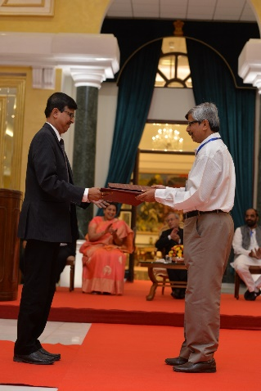





SkyBits - Industry and Academic Ecosystem
Incubation Center at STEP, IIT Kharagpur
Recognized as a start-up company in India by Department of Industrial Policy and Promotion, Ministry of Commerce & Industry, Govt of India (www.startupindia.gov.in)
MoU with IIEST was signed at New Delhi in presence of our Honorable President Mr. Pranab Mukherjee during the Industry-Academia Interactive at Rashtrapati Bhavan on 04 November, 2015.

Slide 4
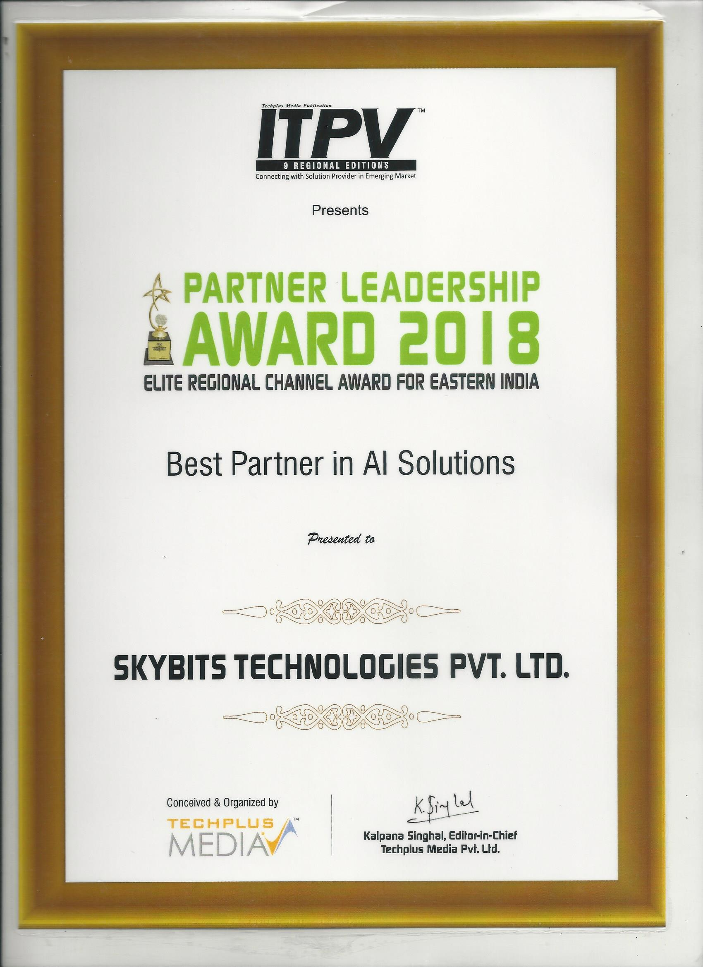

Slide 5










SkyBits : Key Customers
India
Asia
Ministry of Commerce and Industry
DEPARTMENT OF COMMERCE
USA
Sports healthcare

Slide 6
SkyBits : Founders and Management Team
Debabrata Dutta, Founder and Executive Director
Industry Experience: 30 Years
Past Organizations: DRDO, Wipro, Lucent, Ushacomm
Expertise: Machine Learning, Telecom, Parallel Computing,, Mobility
Education: M Tech Computer Sc. IISc Bangalore; B Tech Computer Sc. IIT Kharagpur
Satyajit Roy - Head of International Business Development
Industry Experience: 3 Years
Past Organizations: DNV, Go Marine, Early Stage Start-ups
Expertise: Technology Evaluation, Data analytics, management systems, Business Development
Education: B.S. Electrical Engineering and Economics from
Ambar Mukerji, Executive Director
Industry Experience: 32 Years
Past Organizations: Lovelock/Flakt/Digital (DEC), Xerox, Telstra, UshaComm and early stage companies as CFO/COO/CEO.
Expertise: Financial and Business Management and Business Development and Financing
Education: Chartered Accountant

Slide 7
Tirthankar Banerjee – Advisor
Industry Experience: 30 Years
Past Orgs: Digital, Compaq, Sun, HCL Tech, HP
Expertise: Business Management, Machine Learning
Education: PGDM Marketing IMT; B Tech E&ECE IIT Kharagpur
Capt. Soumitro Roy - Advisor
Sujan Sinha – Advisor
Industry Experience: 40 Years
Past Orgs: Mobil, SCI, Reliance Industries, KOTC, ADNOC
Expertise: Commercial and operational Management of ships, Ani Piracy, Maritime training, Maritime software
Education: St Xavier's Kolkata, Master Mariner
Industry Experience: 37+ years
Past Organisations: SBI, Usha Martin Finance, Axis Bank, Shriram Housing Finance
Expertise: Retail Banking, Consumer Lending, Mortgages
Education: Presidency College, Kolkata
Nirendu Konar – Advisor
Industry Experience: 30 Years
Past Orgs: CISCO, SAIL, Wipro, Mastech, IBS
Expertise: Machine Learning, Deep learning, Business Analytics
Education: M Tech IIT Kharagpur, MBA University of Phoenix

Slide 8
SkyBits – Success Stories
20 feature rich mobile games for Math concepts for a world leader in children educational publishing
Email classification and information extraction for a large bank in India
Fraud company detection for security regulatory body in Malaysia
Statistical analytical model for import export data for govt. organization
Sports healthcare analytics based on mobile games for a US start-up
Cloud based e-learning platform for a large training company
Face recognition based authentication for bank premium customers
Object extraction from engineering drawing images in oil and gas
Video analytics for drone based sea port

Slide 9
Our Solutions and Technologies

Slide 10
SkyBits Solutions and Technologies – Key Areas
Natural Language Processing
Computer Vision
Statistical Analysis
Mobile Computing and eLearning
Artificial Intelligence

Slide 11






SkyBits Solutions and Technologies – Key Areas
Natural Language Processing
Information retrieval, classification of text documents and processing unstructured text in general.
NLP Technologies like Word2Vec, Spacy, NLTK
Deep Learning platforms like Keras on Theano/TensorFlow.
Deep Neural Networks like Recurrent Neural Network (LSTM) for classification and language synthesis.
Related Customer Case Studies
Automatic Customer Feedback Handling
Vendor Names Deduplication
Related Solution Frameworks
Document Summarization
Intelligent Assistants (Chat Bots)
Document Matching
Cyber Security – predict fraud companies

Slide 12



SkyBits Solutions and Technologies – Key Areas
Computer Vision
Deep Learning based techniques Convolution Neural Network (CNN)
Popular Python based tools Keras on top of Theano & TensorFlow, OpenCV
Microsoft’s Azure Machine Learning APIs and IBM Bluemix-Watson APIs
Related Customer Case Studies
Authentication through Face Recognition
Related Solution Frameworks
Information Extraction from Documents
Object Identification from engineering drawing

Slide 13


SkyBits Solutions and Technologies – Key Areas
Statistical Analysis
Modelling and Analysis
Micro simulation for time series prediction, Index computation
Data pre-processing for missing values, out liars and imputation
Related Customer Case Studies
Statistical Analysis of Export Import Data
Statistical Analysis of Reported Income Gap

Slide 14

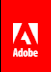


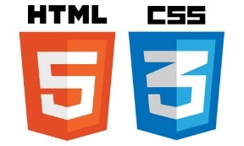
SkyBits Solutions and Technologies – Key Areas
Mobile Computing
Game Development
E-learning platform
Sensor data analysis
Related Customer Case Studies
Mobile Game based Learning Solution
Mobile Sensor Data Analytics
Cloud based Learning Platform

Slide 15



SkyBits : Execution Partners
Reliable Business Technologies Sdn Bhd, Malaysia
GreenField Software, Gurgaon, India
SimpSoft Solutions, Kolkata, India

Slide 16
Glimpses of Projects in North America
Customer - USA | Project | Technologies
Scholastic – educational company | Twenty multimedia rich games on iPads for learning math concepts for you children | Adobe tools, Action Script
J&J - Leading Pharmaceutical company in USA | De-duplication of vendor names and other vendor details | ML classification – SVM and Naïve Bayes
Cadence – Electronic Design company | Google crawl optimization of technical support documents | Python
Sports health start-up in Canada | Mobile sensor data analytics of mobile games for detecting concussion | Adobe tools, Action Script
Dynamic pricing of vacation rentals for a start-up | Dynamic vacation rental pricing | Python, Machine Learning
Camensys – US consulting company | Data engineering for a new analytics tool | JavaScript, Python

Slide 17
Solutions Frameworks

Slide 18
SkyBits Solution Frameworks – At a Glance
Data Sources
Structured Text
ERP
CRM
IOT
Unstructured Text
Email
Social Media
Website
Unstructured Rich Data
Image
Video
Auido
Face Recognition
Vehicle Recognition
Drone, store video analytics
Text Classifier
Summarization
HR Chatbot
Audio classifier
Deployment and Interfaces
On Premises
Cloud
Web API

Slide 19
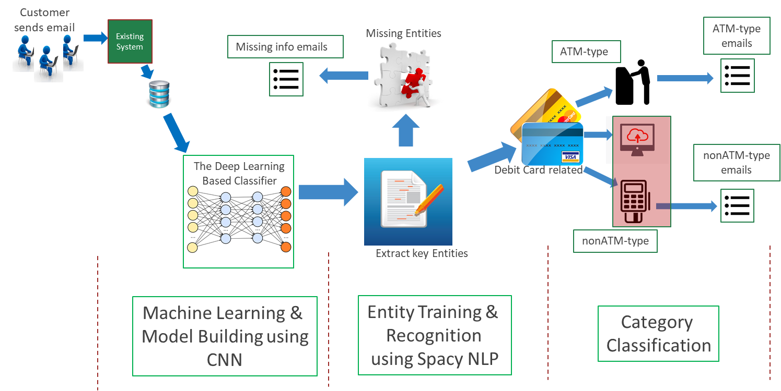
Email Classifier
NLP
Deep Learning

Slide 20
Banking ChatBot
NLP
Deep Learning

Slide 21
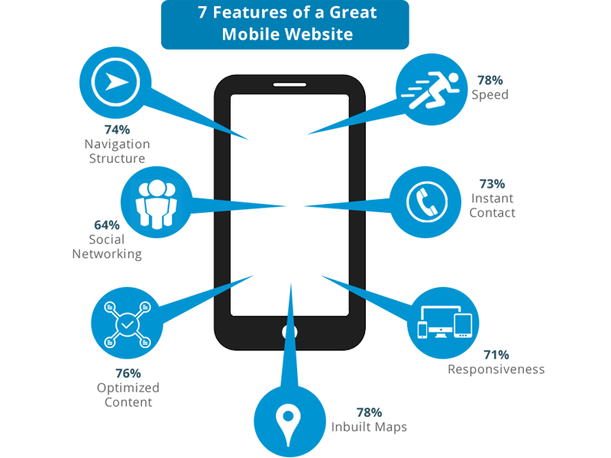


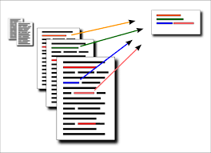

Product Reviews Summarization
NLP
Start
Scrape Reviews in English from multiples Internet sources
Determine the topics in text corpus
Summarize reviews topic wise
Determine the Satisfaction level
Check out our beta on ‘Smartphone Review Summary’:
http://review-analyzer.azurewebsites.net/

Slide 22







HR ChatBOTs
NLP
Multiple use BOTs
Access from variety of platforms or customized
Take customised action based on user input
Web API based
Intent
Entities
Context
Invocation
Response
SkyBits
Application

Slide 23


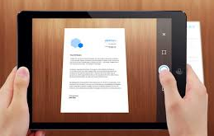


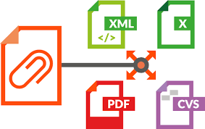

eKYC - Key and Value Document Extraction
Computer Vision
Deep Learning
Scan the documents
Scan and Upload Image
Uploaded documents
Supporting Documents
Enhance Images
extraction of printed data
Extractions of key – value pairs
Extracted data
Documents from current system
Extract to tables
Key-Value Extraction

Slide 24
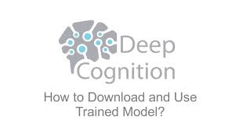
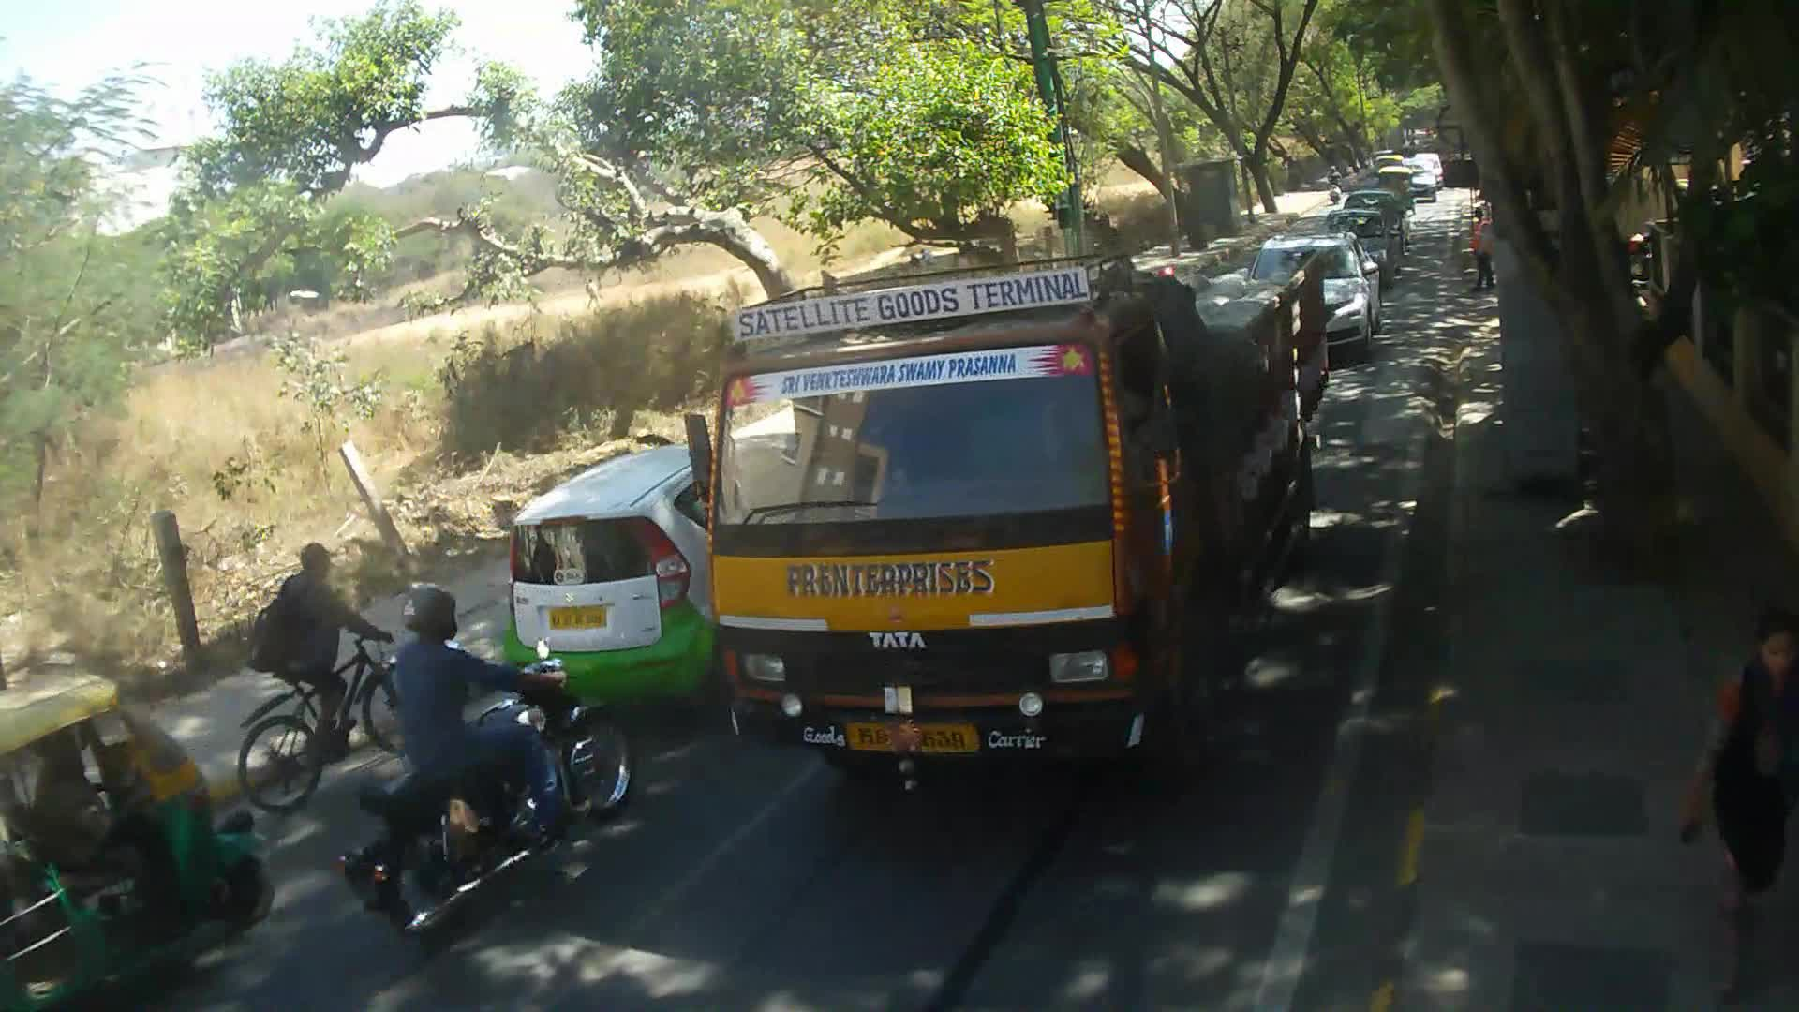

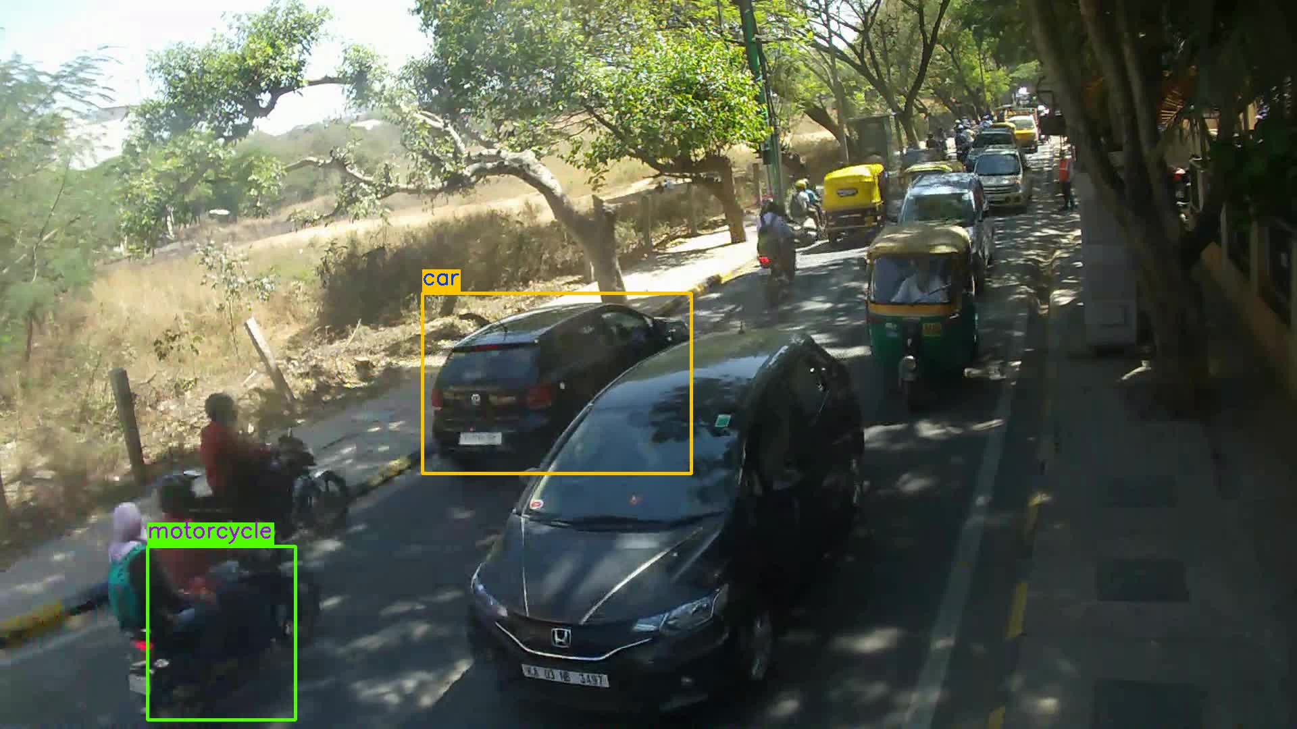
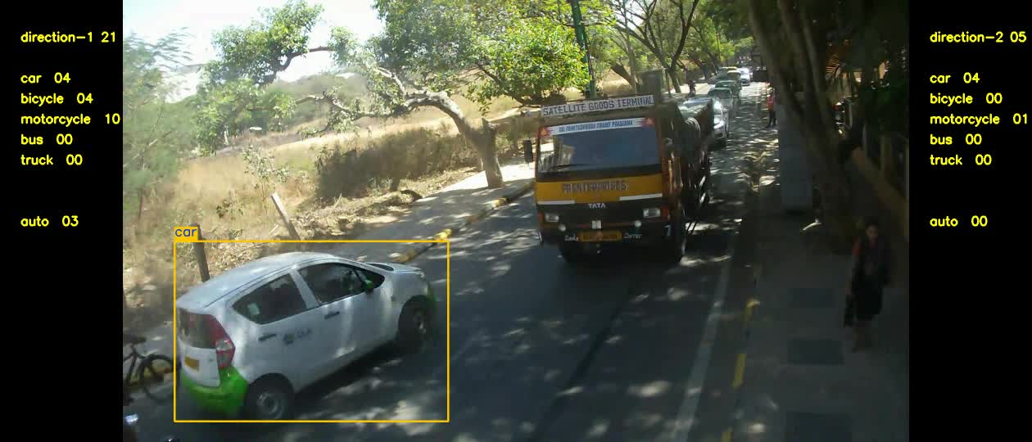
Vehicle Identification
Computer Vision
Deep Learning
Machine Learning
Capture
Tag
Count

Slide 25
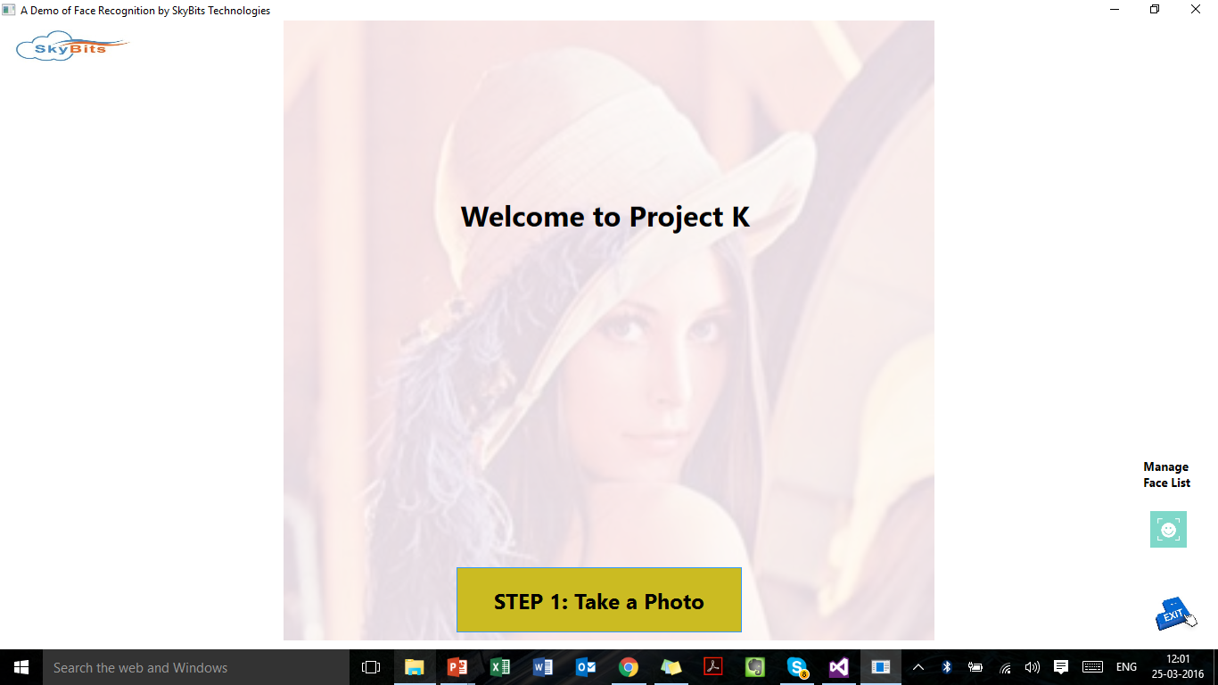
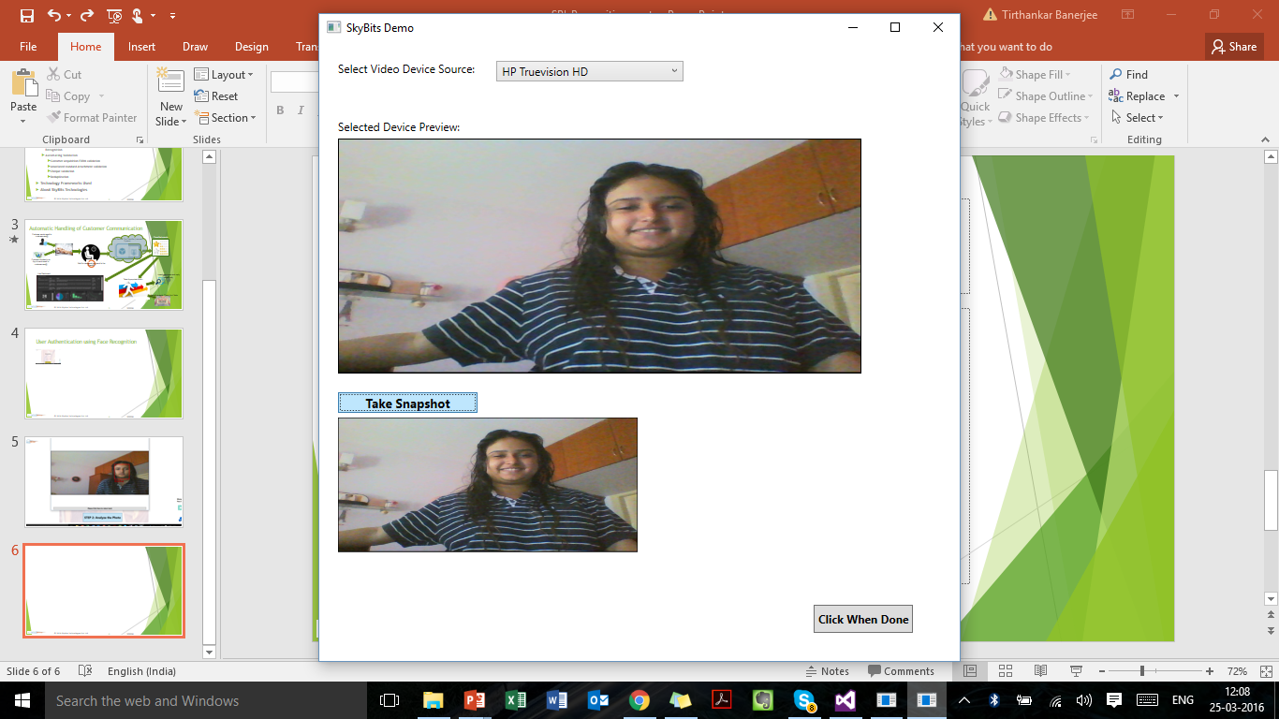
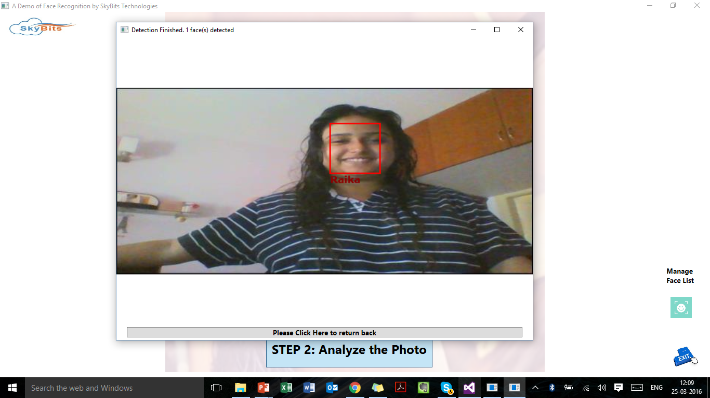
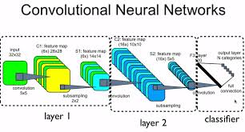
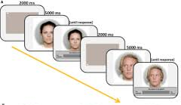
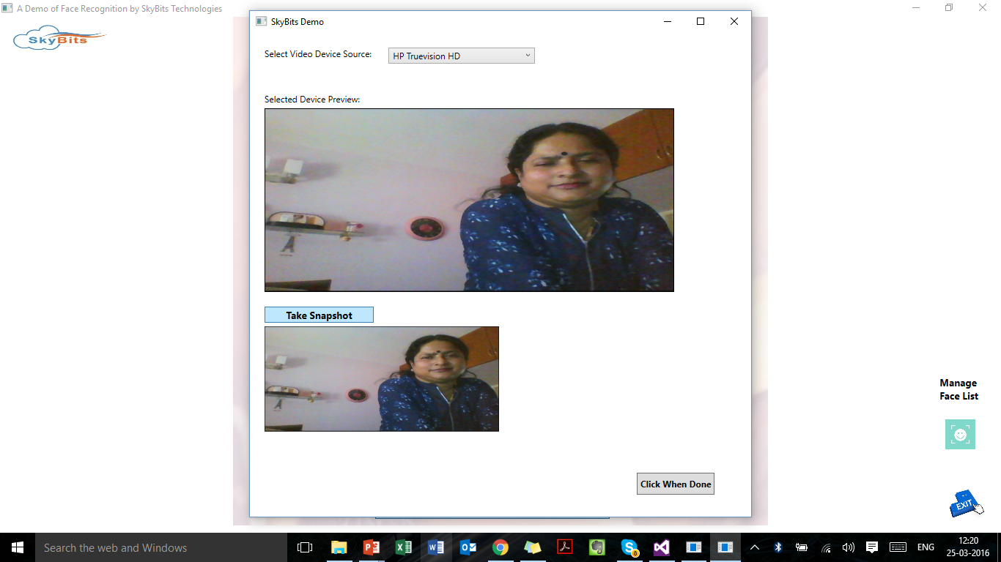
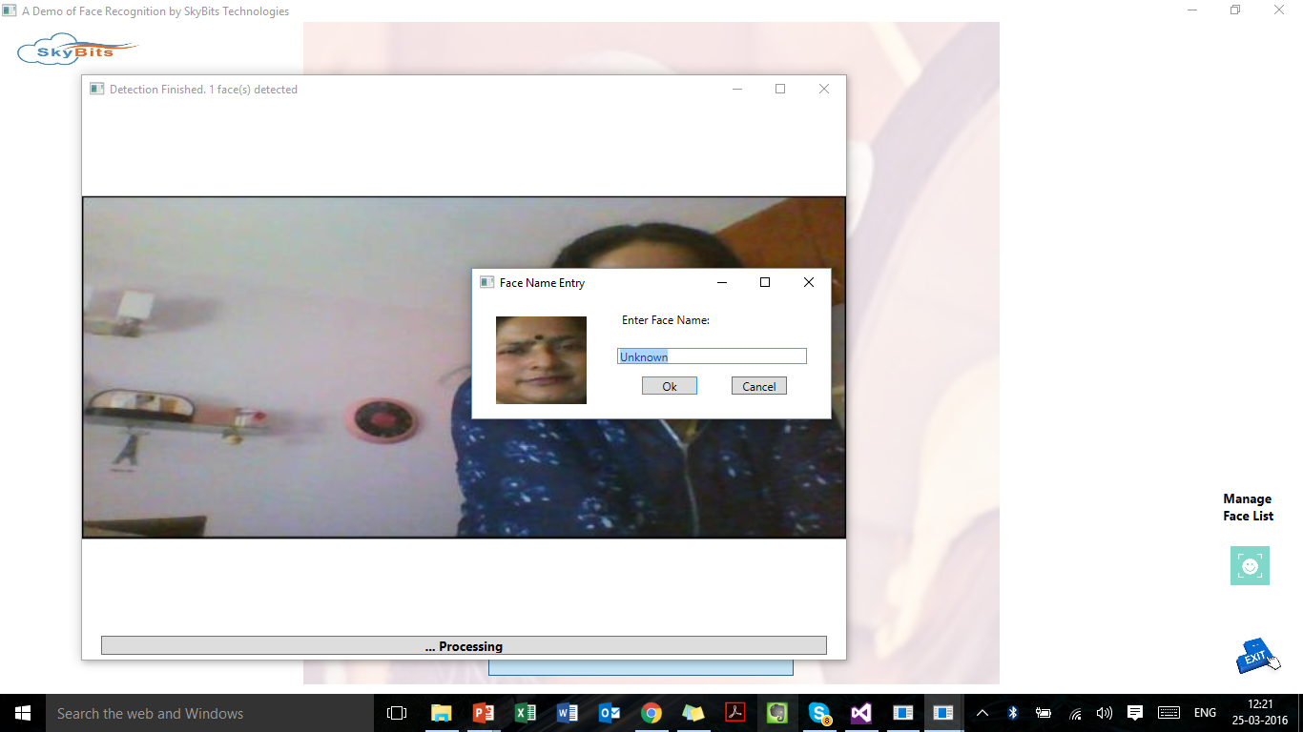
Face Authentication
Computer Vision
Deep Learning
OK
Start
Analyse
Take a Photo/ start video
Add to Face DB
Reject and Report
Take a Photo/ start video
Analyse & Authenticate
further

Slide 26

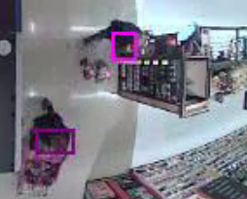
Video Annotation & Analytics
Computer Vision
Deep Learning
Drone Video Analytics
Augment the video streamed by a drone with useful information and graphics like detected critical objects, edge lines
Store Video Analytics
Detect the faces of customers entering the store.
Identify premium customers from face recognition.
Offer real time personalized offers based on past and present shopping patterns.

Slide 27
Case Studies

Slide 28
Unstructured Text Data

Slide 29
Automatic Email Handling
Customer
Largest Bank in India
Executive Summary
The bank gets thousands of emails from customers on various topics. A content based automatic email classier developed to send the mails to correct group tagged with other important information like account number. This helps in much faster response without human error and effort.
Challenges
Large number of mails with no structure
Solution Approach
Cryptic words
Grammatical mistakes
Named Entity Recognition
Multi-class classification
Deep Learning using CNN
Objective
Build a multi-class model and extract key information from the emails

Slide 30
Deduplication of Vendor Names
Customer
A world leader Pharmaceutical company in USA
Executive Summary
The company has large number of vendors of various categories from different parts of the world. Descriptions of various fields of vendors are incorrect, incomplete because of lack of standardizations and lack of English knowledge of some vendors. There was a need for an intelligent classification tool to classify different types of vendors from the semantics of the vendor description fields.
Challenges
Incomplete, misspelled and different standardizations of vendor names, addresses and other fields
Missing data like name, address
Objective
Automatically classify vendors into correct class
Solution Approach
Data Engineering on about 100,000 data points including Data cleaning & validation
Machine Learning Algorithms used to address the key challenges
Pattern matching and String distance algorithms for feature identification
SVM, Naive Bayes for Accurately Classifying the Strings into Binary Classes

Slide 31
Prediction of fraud companies
Customer
Regulatory body in Cyber Security
Executive Summary
Problem Description: proliferation of Internet and online technologies have given rise to many “fly by night” companies whose only intention is to deceit customers with mainly financial frauds.
Challenges
Historical data like websites not sufficient
Objective
Develop an Artificial Intelligence based system which can predict if a company might be fraud based on various sources of data like:
Solution Approach
With the help of domain experts in cyber security, a list of features were arrived at which contribute to the decision of a company being a fraud company. Data were extracted from websites through automatic scrapers. Finally a machine learning based model was trained using all the extracted features from the dataset and the model could predict with probability the fraud companies, given a new company name.
Company website data
Government reports
Social media data
News articles
Multi lingual data

Slide 32
Structured Data

Slide 33
Export Import Index Data Analytics
Customer
Government Organization
Executive Summary
Statistical Model for price index computation and analytics with prediction
Challenges
Huge import export data for past 10 years
Objective
Build statistical model for index computation and various analytics
Solution Approach
Cleaning of data – missing values, outliers
Statistical Model for index computation and analytics
Prediction model based on regression
Mismatch due to various methodologies
Missing data and outliers
Predict index for coming months and years

Slide 34
Unstructured Image Data

Slide 35
Face Recognition based Authentication
Customer
Bank in India
Executive Summary
Customer authentication based on face recognition of the customer
Challenges
Face detection and recognition against stored face database
Objective
Authenticate the live video having actual customer face
Solution Approach
Use techniques like eye blinking to authenticate live video
Face detection from frames of the video
Presence of multiple faces
Face detection from live video clip
Detect the face and search for a possible match
Face recognition

Slide 36
Object Identification from Engineering Drawings
Customer
Global engineering consulting group in Oil industry
Executive Summary
Extract key information from large engineering drawings in PDF formats
Challenges
Large drawing files with extensive layouts having engineering objects and lines
Objective
Extract key information like types, numbers of objects and relationship amongst various objects
Solution Approach
Hybrid approach
Similar objects, complicated lines, overlapping annotations
Image processing based segmentation, extraction ad identification
Structured meta data from PDF files
Build signature (image to data conversion) for each object
Search for the signature in the drawing search image

Slide 37
Expertise - Mobile Solutions

Slide 38

MATH 180 - Mobile E-Learning Games
MATH 180 is an e-Learning product to address the needs of struggling students in grades 5 and up, and their teachers, equally—building students’ confidence with mathematics and accelerating their progress to algebra.

Slide 39
MATH 180 - Mobile E-Learning Games
Application scope includes 9 educational blocks and 15 educational games
Each bock has three zones – explore, learning and success
Delivered on
multiple models of tablets
different OEM (Samsung, HP, LG, Google)
Supported Platform
Android
iOS

Slide 40
More about
MATH 180 - Mobile E-Learning Games
What is Math 180?
“MATH 180, an exciting new math program that blends teacher instruction with innovative technology to help students become stronger and more capable math students.”
http://www.hmhco.com/products/math-180/family/
YouTube Videos
Introduction
https://www.youtube.com/watch?v=u0OSi8vBsug
Explore Zone
https://www.youtube.com/watch?v=uA9Zm4cI3sA
Learn Zone
https://www.youtube.com/watch?v=bmoRv3FB5ks
Success Zone
https://www.youtube.com/watch?v=ArfoY-LUPgw
Brain Arcade
https://www.youtube.com/watch?v=NP2X2BhHkd8

Slide 41
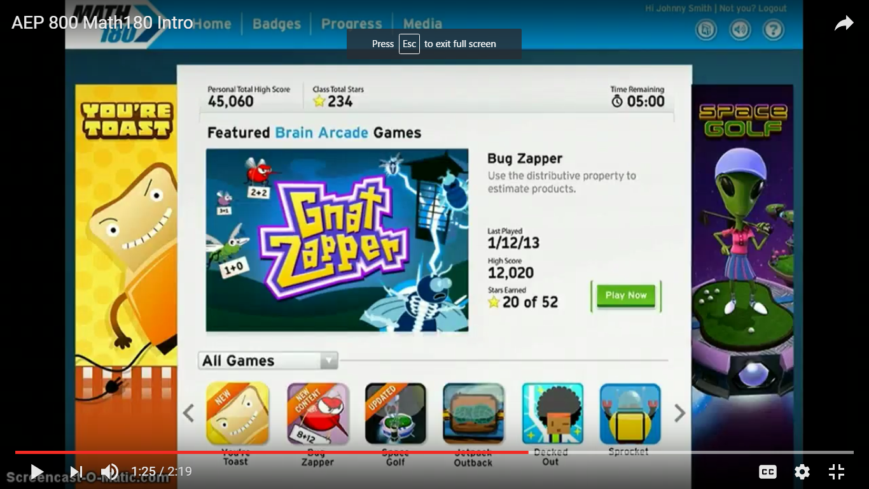
More about
MATH 180 - Mobile E-Learning Games
Brain Arcade – Games to Learn Math
Fifteen games to teach different Math concepts at different levels

Slide 42
Case Study – Mobile App for Sports Healthcare

Slide 43
Case Study : Mobile App for Sports Healthcare
Background:
This application is designed for testing concussion for Sports Players by using various activities on the mobile app
Scope
Development of backend logic and UI on Android tablets
Deliver on
multiple models of tablets
different OEM (Samsung, HP, LG, Google)
Supported Android Platform includes Jelly Bean and above
Technology Stack
Adobe AIR on Android
Apache Flex, Adobe Flash, Adobe Flash Builder
Image Editing Tools - Photoshop
Flash Animation (2D and 3D)
GIT for configuration management
JIRA for bug tracking

Slide 44
Case Study – Cloud based Learning System

Slide 45
Case Study : Cloud based Learning System
Scope
Amazon AWS Cloud based training and learning platform
All the activities of a training are cloud based
Lab
Test
Teaching
Assignment
Cloud based assures centralized control and identical environment for all participants
Technology Stack
Moodle – the most popular and open source platform
MySQL, JAVA, PHP
Remote Desktop Services of Windows for Lab on the cloud

Slide 46



SkyBits Technologies Private Limited
Kolkata
Mumbai
Registered Office
1416 DLF Galleria,
Action Area 1B, New Town,
Kolkata 700156, INDIA
www.sky-bits.com
info@sky-bits.com
Abu Dhabi
Kuala Lumpur

